Slide 1



Presentation cover slide example: Vertical white logo on blue background
Designing an Evolvable Clinical Workflow System
Student: Konstantinos Chanioglou MSc CSE
Supervisors: Johan Lukkien (TU/e) – Aly A. Syed (Philips)
16/7/2025

Slide 2

Agenda
Introduction
Thesis Objectives & Research Questions
Literature Review
Requirements Analysis
System Architecture & Design Concepts
Proof of Concept
Evaluation
Contributions

Slide 3
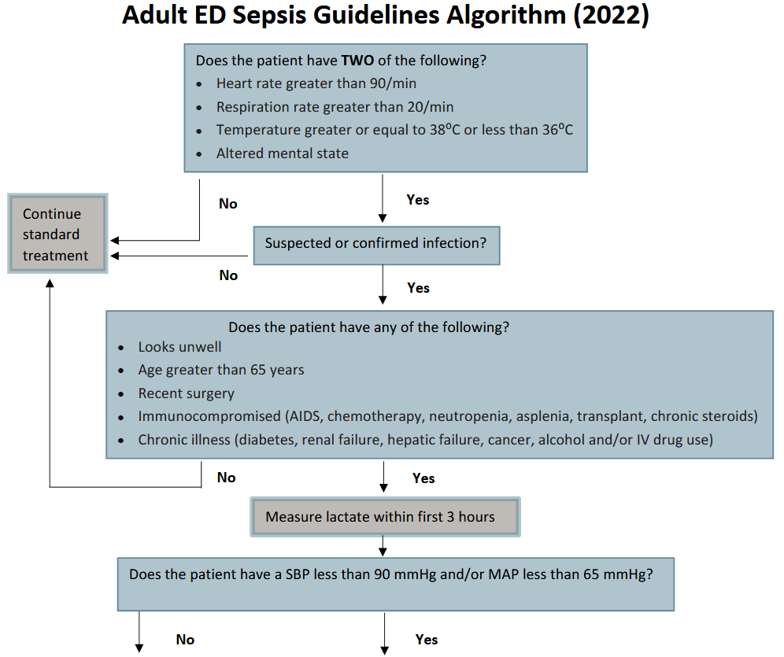

Introduction
Clinical Workflows
Structured sequence of tasks that coordinate care across clinicians and systems.(e.g., patient admission, sepsis diagnosis).
Each hospital implements their workflows based on published clinical guidelines (e.g., from WHO, BC Sepsis Network).
Workflows implementation vary across hospitals due to local policies, infrastructure etc.
Clinical Workflow System (CWS)
Responsible for implementing, executing, managing clinical workflows
CWS stand as subsystems in medical products (e.g. patient monitor)
Interact with hospital environment (staff & systems) for completing workflows execution
Key Stakeholders: Clinicians, Caregivers admins, Vendors’ Engineers
Notes:
Clinical workflows are structured sequences of tasks that coordinate care across clinicians and systems. For example, a workflow can describe a patient admission or sepsis diagnosis.
Each hospital typically implement its workflows based on published clinical guidelines by health organizations the WHO or the BC Sepsis Network.
And this is an example of Sepsis diagnosis workflow guidline, describing in a stepwise manner the tasks need to be done for the diagnosis and treatment to take place.
Workflows implementations across hospitals vary due to local policies, resource availability, and IT infrastructure.
But where these workflows are implemented and exectuted.?
Clinical Workflow Systems, or CWSs, are digital subsystems embedded in medical products, like patient monitors or HIS, that are responsible for implementing, executing and managing these workflows.
They manage and track workflow execution, interact with hospital environments, and communicate with both clinicians and external systems.
Key stakeholders include clinicians, caregivers, hospital administrators, and engineers from medical device vendors.

Slide 4
Introduction - Thesis Objectives
Challenges with Current CWS
Hard-coded workflows
Require system customization, maintain different system releases per hospital.
Integration is difficult due to heterogeneous IT environments (EHRs, EMRs, LIS, etc.).
Core Problem
CWSs cannot adapt to hospital-specific workflows or hospital environments without code changes.
Thesis Objective/Gap - Design an evolvable CWS:
Ability of a system to accommodate changes with minimal cost while maintaining its architectural integrity.
Supports workflow customization & system adaptation to different environments without code modification.
Utilize single CWS release across hospitals.
Notes:
This thesis was based on the given challenge that workflows in the current CWS are hard coded
And to adapt workflows on different hospital needs the system need to be customized and a different system release to be maintained for each hospital
Also the CWS need to be capable of adapting in different hospital environments without needing of creating a new release for this
- The solution is to design an evolvable CWS. But what evolvable means? While evolvability is still not clearly defined, it is generally considered as the ability of a system to accommodate changes with minimal cost while maintaining its architectural
integrity.
- Evolvability in our project context means a CWS that can customize its workflows and adapt to different hospitals sytste without needing to produce a different system release and thus without code level changes.

Slide 5
Literature Review
Two focus areas:
System Evolvability Studies
Studies focusing on Clinical Workflows & CWS
System Evolvability Studies
Evolvability Assessment Performed
System Architecture Considered
Requirements/Infusion Requirements
Literature Review Conducted
Case Study Included
Empirical Study Conducted
Clinical Workflow & CWS Studies
Workflow Modeling and Formalization Discussed
CWS Architecture & Components Discussed
Causes of Clinical Workflow Variations Identified
Real-World Clinical Workflow Guidelines Examples
Notes:
To address this problem, I conducted lit review in two main topics
For system evolvability Studies
-

Slide 6
Literature Review – Summary & Insights
Viewpoint | Methods/Ideas Used in Literature
System Requirements | PESTEL analysis, scenario-based analysis, (Delta) DSM
System Architecture/ System Qualities for Evolvability | Design for Changeability (DfC) - Qualities selection (adaptability, scalability, extensibility, modularity, robustness, flexibility, and agility.), dynamic reconfiguration (e.g., JADDA), reverse architecting, A3
System Architecture for CWS | Workflow engine
Workflow Variation Causes | Reveal workflow configuration points due to medical expertise, organizational context, decision-making, regulations etc.
Workflow Modeling | Petri Nets, UML, XPDL/XML, computer-interpretable models
Evolvability Assessment | Scenario-based evaluation, expert judgment, Delta DSM, Epoch-Era Analysis
Case Studies | MRI systems, Philips architecture, microservice evolvability, SASE framework
Notes:
1. System Requirements
“For system requirements, I drew directly from the literature’s use of PESTEL analysis and scenario-based methods. These helped me identify both current and evolving needs from stakeholders and external forces like regulation and technology trends. While persona-based approaches and DSM were interesting, I focused on the first two to match my project goals.”
🔹 2. System Qualities for Evolvability
“To guide architectural decisions, I used existing frameworks that harmonize system qualities, especially those related to changeability — like adaptability, modularity, and scalability. These qualities were selected based on literature but applied specifically to the clinical workflow system context.”
🔹 3. System Architecture
“A key influence here was the principle of Design for Changeability (DfC) by Fricke and Schulz. I used it to select guiding principles like modularity and simplicity to support long-term evolvability. Other concepts like modular architecture and reverse architecting were reviewed but not directly applied.”
🔹 4. System Architecture for CWS
“The CWS architecture draws from literature that emphasizes the use of workflow engines for dynamic execution. I also reviewed how other systems integrate with hospital IT environments to ensure flexibility and generalization in my design.”
🔹 5. Workflow Variation Causes
“Literature shows that workflows vary across hospitals due to factors like medical expertise, organizational context, and infrastructure. These insights validated my focus on adaptability, because a one-size-fits-all system would never meet all hospitals’ needs.”
🔹 6. Workflow Modeling
“To represent clinical workflows in a computer-executable way, I adopted Petri Nets — which are widely used in the literature for capturing workflow behavior. Other formalisms like UML and XPDL were reviewed but Petri Nets were a better fit for showing transitions and dependencies.”
🔹 7. Evolvability Assessment
“For evaluating how the system responds to change, I followed a scenario-based evaluation method — this aligns with both the literature and the dynamic nature of the system. I didn’t apply more formal frameworks like DSM or Epoch-Era Analysis, but they provided useful context.”
🔹 8. Case Studies
“Lastly, several studies use real-world case studies — including in Philips systems. I followed this model by constructing a structured case around my proof-of-concept CWS implementation and applied scenarios to demonstrate configurability and adaptability.” Qualities related to evolvability are not standard in each project. They need to be selected based on the problem context

Slide 7
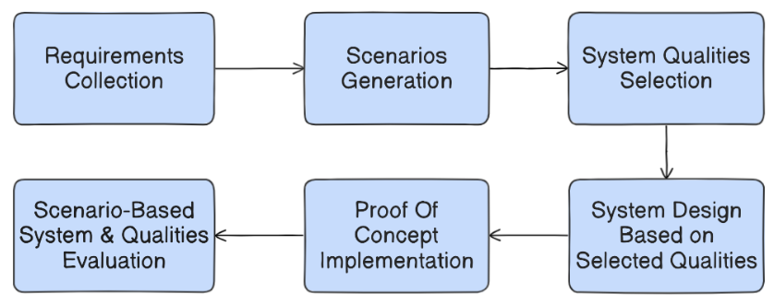
Research Questions & Methodology
RQ1: What are the key characteristics and evolving requirements of clinical workflows & CWS that should be supported by the proposed system design?
RQ2: How can the CWS architecture be designed to support workflow configurability and system adaptability without requiring code-level modification and satisfy the identified current and future system requirements?
RQ3: What are appropriate criteria/metrics/questions for assessing evolvability of CWS?

Slide 8
Requirements Analysis - Workflow Analysis
Clinical Workflow (Technically): A procedure consisting of a structured, predefined series of tasks, decision points (conditions), transitions, and events whose execution achieves a defined outcome, standardizing care delivery.
Element | Definition (Simplified Notation)
Task | Executable action performed during workflow execution.
Condition | A logical decision point that influences the control flow of the workflow.
Event | A trigger that initiates, continues, or terminates the workflow.
Transition | A directional control flow between tasks, conditions, and events.
Simplified Notation Elements:
Notes:
captures the main conceptual elements of a clinical workflow
Place: Represents a condition, event in the system and can hold tokens.
Transition: Represents an action or event that changes the system’s state when triggered.
Token: Represents the presence of a resource/information and indicates the system’s current state.
Directed Arc: Defines the flow and dependencies between places and transitions, showing how tokens move.
Note: In the simplified notation, "transitions" refer to directional control flows between components, not Petri net transitions.

Slide 9
Requirements Analysis - Workflow Analysis
Evaluate for Infection
Confirmed Infection
Yes
(c(W)+c(A)+
c(S)+c(I)+c(C))
≥1
Yes
Measure Lactate (within 3 hours)
Evaluate Patient Wellness (W)
…
Measure Heart Rate (H)
Yes
Record Age (A)
Measure Temperature (T)
Assess Surgical History (S)
Start
(c(H)+c(T)+
c(R)+c(M))
≥2
Measure Respiration Rate
(R)
No
Evaluate Immune Comptonization (AIDS etc) (I)
No
No
Evaluate Mental Status
(M)
Check for Chronic Illness (C)
Continue Standard Treatment
…

Slide 10
Requirements Analysis
Workflow Component | Variation Point
Task | Precondition/Postcondition
 | Execution Time Constraint
 | Actor
 | Entire Task
Transition | Entire Transition
Condition | Condition Expression
 | Entire Condition
Event | Entire Event
Workflows vary on multiple points:
All must be configurable, no code changes required.
Domain | Key Changes | Impacts | Category
Political | Guideline accessibility | Workflow content changes | 1
Economic | Resource Availability | System & Staff dependencies/ Task timing | 1, 2
Social | Patient care & clinical preference | Task logic/order | 1
Technological | Infrastructure & Support Systems | Integration & deployment methods | 2
Environmental | Local practice & Org. structure | Actor roles, coordination | 1, 2
Legal | Guidelines & Privacy laws | Workflow rules, secure integration | 1, 2
PESTEL Analysis Insights:
Category:
1 = Workflow Configurability
2 = Integration & Deployment
Notes:
However, if someone evaluates the impact of this category the other way around,
it could be argued that even a single unmet requirement would likely cause the system to fail
in supporting the desired functionality

Slide 11
Final Requirements - System Qualities
Workflow Configurability
Reconfigure workflows without code changes
Supports local custom clinical preference
System Adaptability, Flexibility & Integrability
Integrates with EMR/EHR/CDSS/etc.
Handles protocol, interface, and data format variations
Deployment Flexibility & Adaptability
Supports centralized (cloud/server)
Per-patient (edge/device) use cases
Change Scenarios for each requirements have been construed
Key driver Qualities:
Configurability, Adaptability & Flexibility, Integrability
Supportive Qualities:
Modularity, Maintainability, Extensibility, Scalability, Upgradability, Robustness, Resilience
Notes:
Configurability: In CWS, configurability refers to the ability to define and modify clinical
workflows through external configuration files, without altering or recompiling source code.
This includes configuring workflow variation points such as task order, transitions, roles,
conditions, and events. A system is considered configurable when the relevant workflow
changes can be applied through configuration alone, taking effect without requiring a new
system build or redeployment. Configurability is not satisfied if changes require modifying,
recompiling, or redeploying system code to update the system behavior.
• Adaptability & Flexibility: Adaptability refers to the ability of the CWS to operate in
different hospital environments by reconfiguring its use of external systems without code
changes. Flexibility refers to the ease with which these adaptations can be performed at
deployment or runtime. The system is considered adaptable and flexible when differences in
external systems and infrastructure can be resolved using configuration alone, and no core
logic (engine, UF, adaptors) must be changed.
• Integrability: Integrability means that the CWS can integrate with new external systems
and services by introducing new adaptor components, without modifying any other system
components. Integration is considered successful if a new adaptor can be implemented and
no changes are needed to any other system’s component.
Extensibility Extensibility means we can add new Unit Functions or adaptors without changing existing code. If adding something new breaks what’s already there, extensibility is not achieved.
Scalability Scalability is the system’s ability to handle more workflows or users by increasing its capacity—like spinning up more components when needed.
Modularity Modularity means the system is built from separate parts, each with its own job. We can change one part without affecting the others.
Robustness Robustness means the system keeps working properly even when external systems change or temporarily fail.
Maintainability Maintainability is about how easily we can fix or improve the system. A change should be local, not ripple through unrelated parts.
Upgradability Upgradability means we can upgrade individual components—like a UF or adaptor—without having to rebuild or redeploy the whole system.
Resilience Resilience is the ability to recover from failures. The system should retry, reroute, or continue gracefully if something goes wrong.

Slide 12

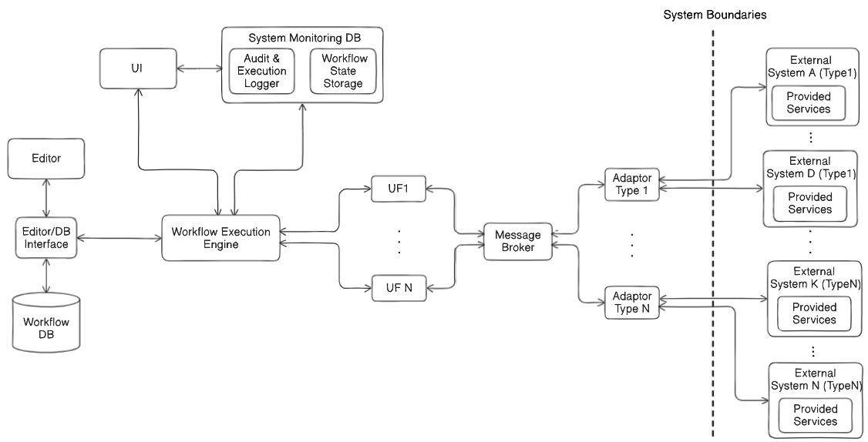


System Architecture Overview
Component | Role in System
Execution Engine | Instantiates and orchestrates workflows based on definitions, triggers appropriate UFs for task execution, manages workflows instances states.
UI | Shows workflow state, collects input, and handles manual tasks
Monitoring DB | Stores workflow state for auditing and failure recovery
Component | Role in System
External Systems | Devices and systems like patient monitors, EHRs, etc.
Adaptors | Interface with different types of external systems; manage interoperability (protocols, data formats); maintain patient-to-system mappings and resolve invocation priorities.
Message Broker | Facilitates asynchronous publish-subscribe messaging between UFs and adaptors; ensures complete decoupling between UFs and adaptors.
Component | Role in System
Workflow Editor | Enables creation and reconfiguration of workflow definitions; ensures syntactic correctness and clinical semantic validity.
Workflow DB | Stores workflow definitions in a structured configuration format
Component | Role in System
Unit Functions | Single clinical responsibility services; Encapsulates functional logic; enable configurable and reusable workflows.
Notes:
The system uses a single execution engine to interpret external workflow configuration files at runtime, enabling full workflow configurability without modifying or redeploying code.
Clinical tasks are implemented as Unit Functions (UFs)—modular, reusable, and independently testable components that encapsulate specific task logic and can be flexibly reused across workflows.
Adaptors act as bridges between the system and external hospital systems, handling interoperability, data translation, and routing—thus enabling system adaptability to different environments without internal code changes.
This architecture separates control logic (defined in configuration files) from functional logic (UFs and adaptors), ensuring that the system remains configurable, extensible, and maintainable as workflows and environments evolve.
Here explain that the Ufs provide a pretested functionalities that can be used as is in the workflows without needing any new testing and also do not enfrce to exress the functionality needed in the workflow as is done currently using BPN lets say.

Slide 13
Design Core Ideas
1
2
3
4
Separation of control logic and functional logic. Workflows are defined in configuration files and interpreted at runtime by an execution engine which triggers UFs.
Clinical tasks are implemented as modular, reusable Unit Functions (UFs).
Adaptors enable interaction with diverse hospital systems, ensuring adaptability and interoperability.
UFs – Adaptors decoupling
through message broker. This supports further the CWS adaptability to the external environment.
5
Separation of system components responsibilities supports modularity, which makes the system support almost all the selected qualities

Slide 14
Components Descriptions & Responsibilities
Component | Role in System
Unit Functions | Reusable building blocks; each implements one clinical task (e.g., take temperature)
Component | Role in System
Workflow Editor | Used to reconfigure workflows without code changes
Workflow DB | Stores all workflow definitions in BPMN or config format
Component | Role in System
External Systems | Devices and systems like patient monitors, EHRs, etc.
Adaptors | Communicate with external systems and manage interoperability
Message Broker | Connects UFs and Adaptors using publish/subscribe messaging
Component | Role in System
Execution Engine | Runs workflows from config files and triggers Unit Functions (UFs)
Unit Functions | Reusable building blocks; each implements one clinical task (e.g., take temperature)
UI | Shows workflow state, collects input, and handles manual tasks
Monitoring DB | Stores workflow state for auditing and failure recovery

Slide 15
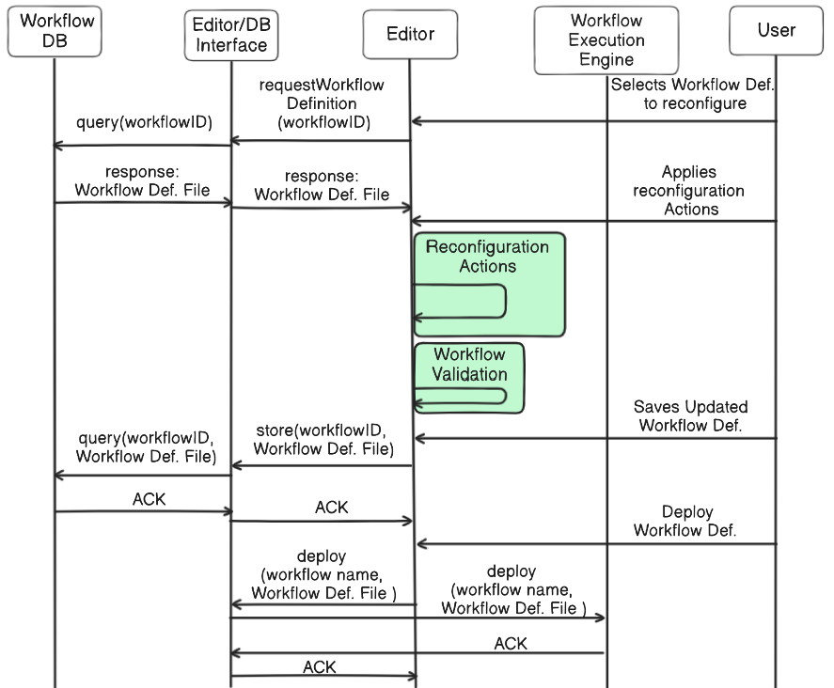
System Behavior - Workflow Reconfiguration
Figure: Workflow Reconfiguration

Slide 16
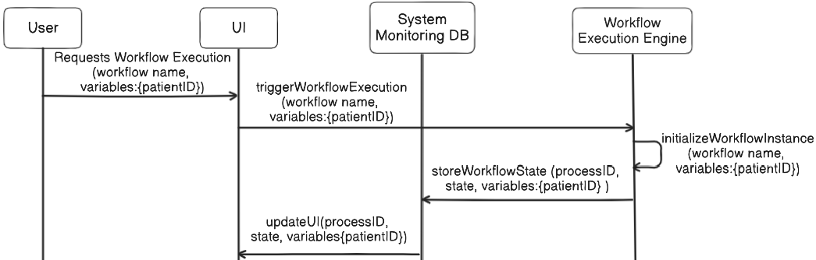
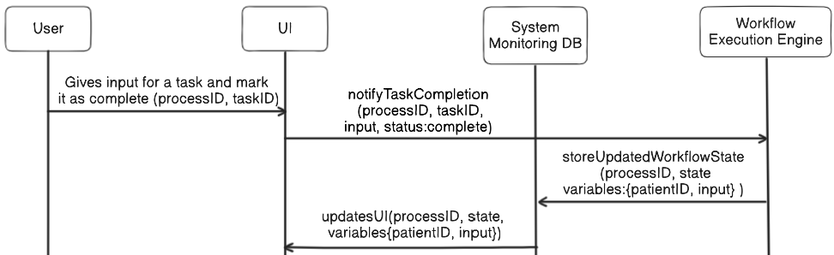
System Behavior
Figure1: Workflow Execution Trigger
Figure2: Manual Task Execution & System Components Interaction

Slide 17
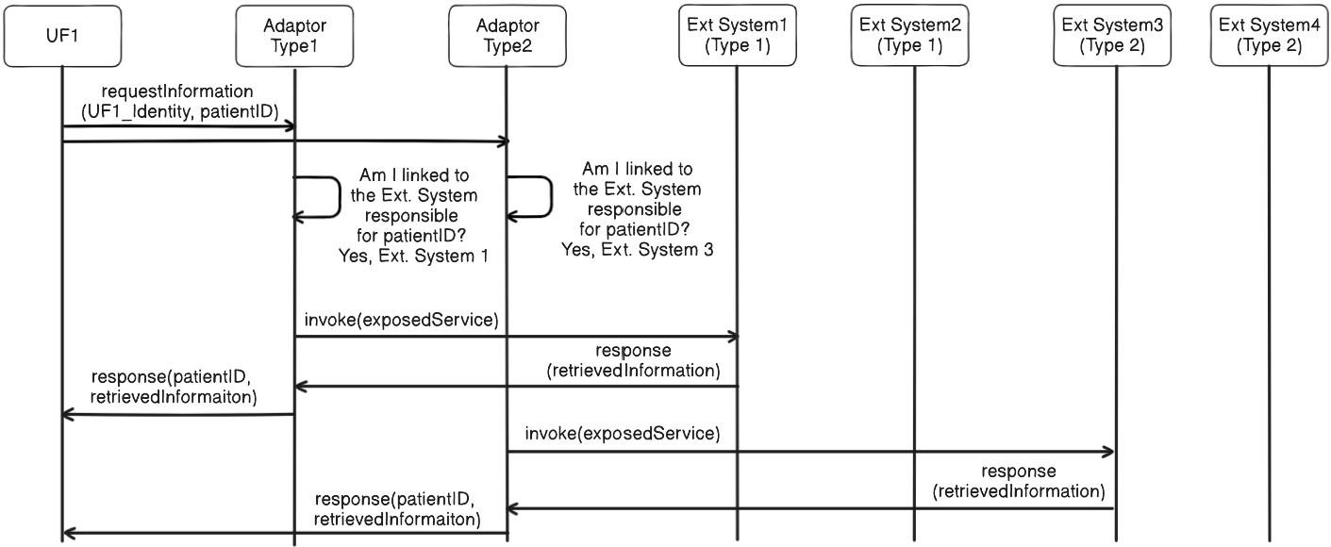
System Behavior – Adaptation to environment
Figure: UFs – Adaptors – External Systems Interaction

Slide 18
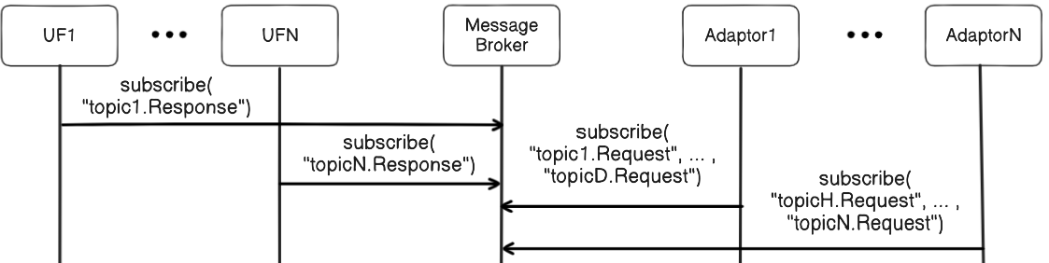
System Behavior
Message Broker Initiation Phase

Slide 19
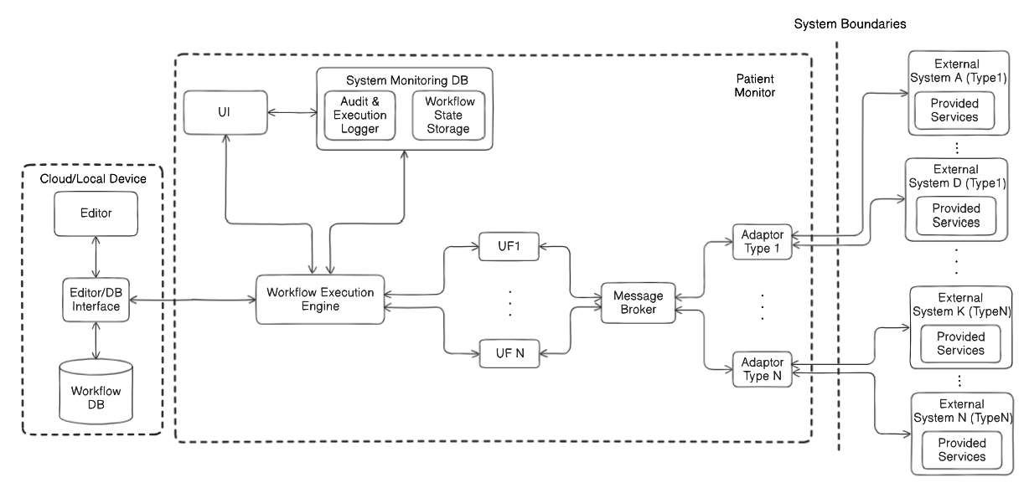
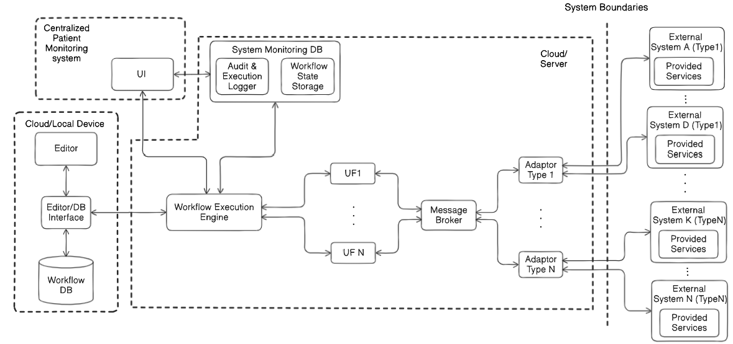
Deployment Flexibility & adaptability
Central: Server/cloud (e.g., hospital network)
Edge: Per-patient devices (e.g., ambulance monitor)
Mixed mode possible with synchronization
Per Patient Deployment
Centralized Deployment

Slide 20
Requirements Alignment & Trade offs
Requirements Alignment:
Workflow Configurability: Config files + Execution Engine + UFs
System Adaptability: Adaptors + Message Broker
Deployment Flexibility: Modular deployable components
Design Choice | Trade-Off
Centralized Engine for workflow orchestration | Single point of failure
Decoupled UFs & Workflows (Control & Functional Logic) | Higher upfront development effort
Adaptors for External Integration (vs Blackboard) | Maintenance when APIs/protocols change
Mapping Logic Inside Adaptors (clear separation of concerns) | Possible redundant message processing
Distributed Components for Testability | Debugging becomes multi-layered
Faced Trade Offs

Slide 21
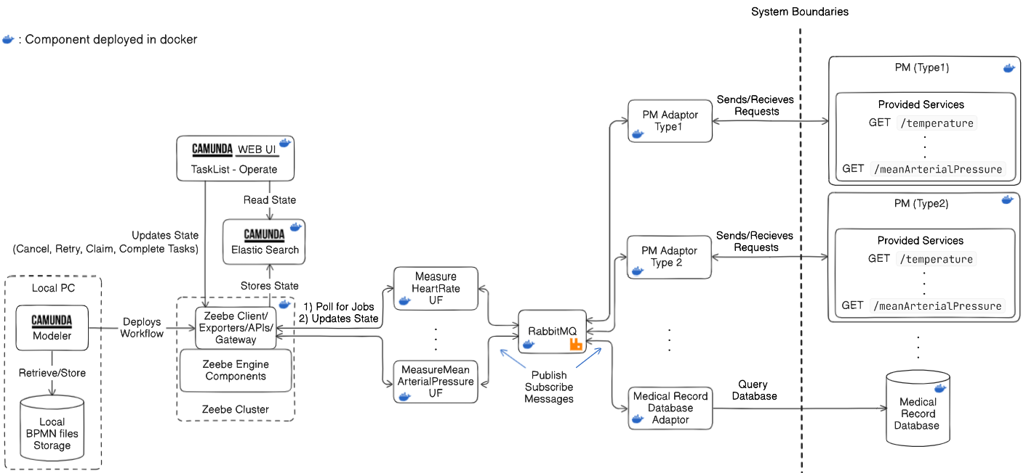
Proof of Concept
Proof of Concept Goal: Demonstrate that the system design is feasible and satisfies requirements.
Design – Implementation Mapping
Component (Design) | Implemented With
Editor | Camunda Modeler (BPMN)
Workflow Engine | Camunda Zeebe
UI | Camunda Tasklist + Operate
Monitoring DB | Elasticsearch
UFs | External worker containers
Adaptors | REST-based adaptors per system
Message Broker | RabbitMQ
External Systems | Simulated Two PMs types + EMR

Slide 22
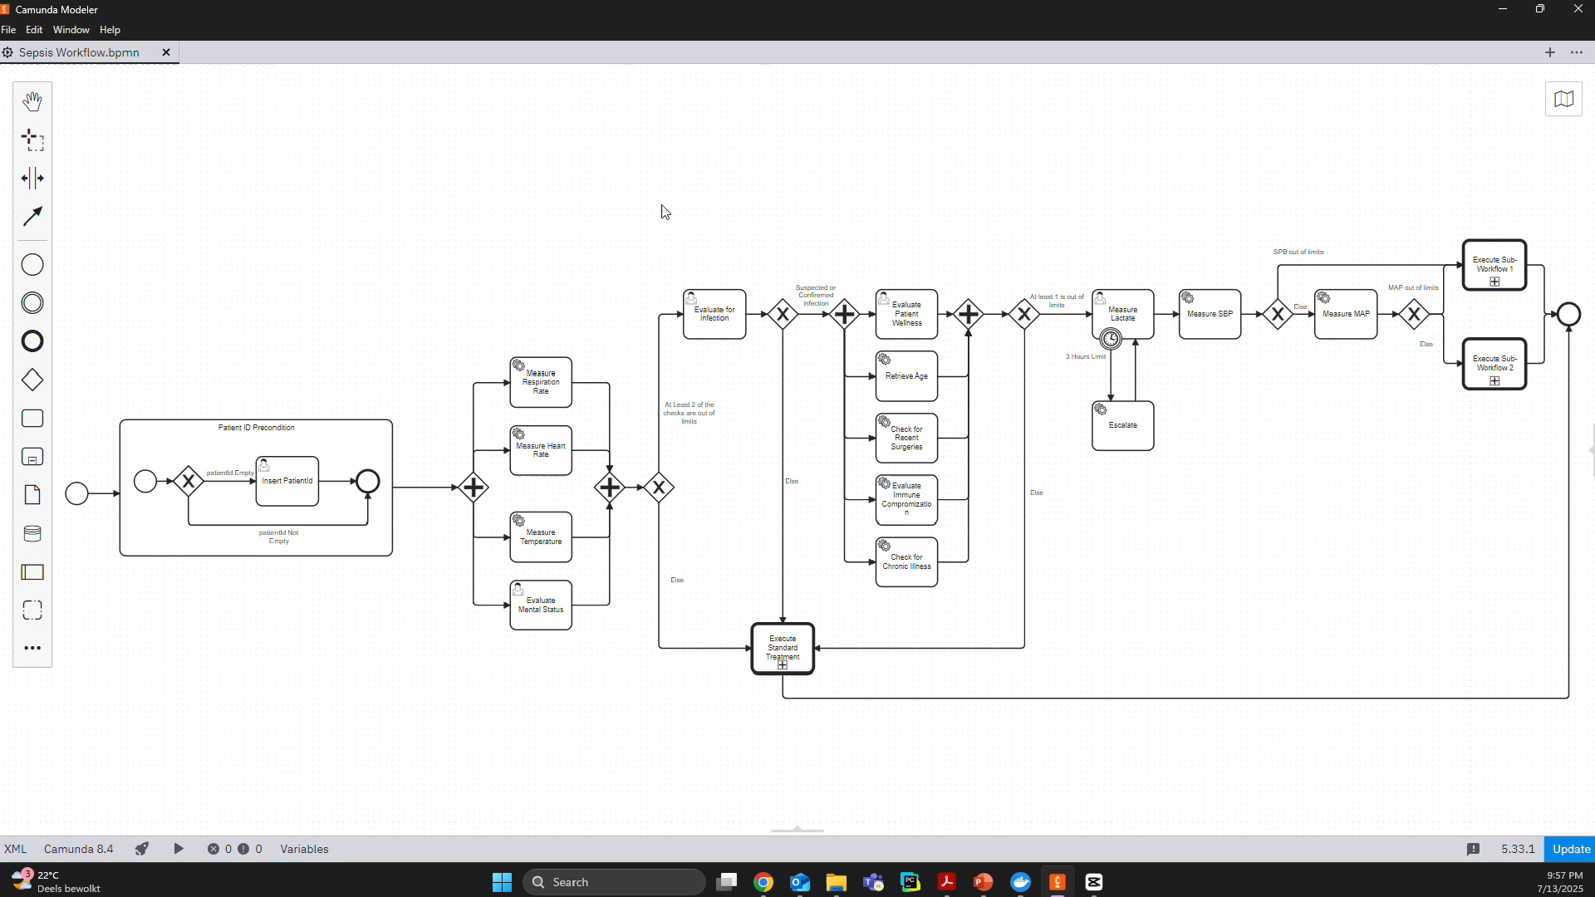
Proof of Concept - Video

Slide 23
Proof of Concept - Video
Requirements Demonstration Video
Requirement | How It Was Satisfied
Workflow Configurability | BPMN definitions editable in Camunda Modeler; no code change needed Show that deployed Sepsis run correctly (Show Camunda Operate + Tasklist) Do one reconfiguration + Syntax Check Deploy Trigger from PM Execute show all data Show that it runs correctly -Run Multiple workflows to referct on the Deployment requirement in the evaluation Also simulate Robust and Resilience scenairos
System Adaptability & Integrability | Adaptors support multiple PM/EMR systems without modifying UFs or workflow engine Show execution with one adaptor enabled and then with the other. Show Logs that executes correctly
Deployment Flexibility | All components are independently containerized and can be deployed centrally or locally - Show the docker containers and explain that containers run independently of the hardware.

Slide 24
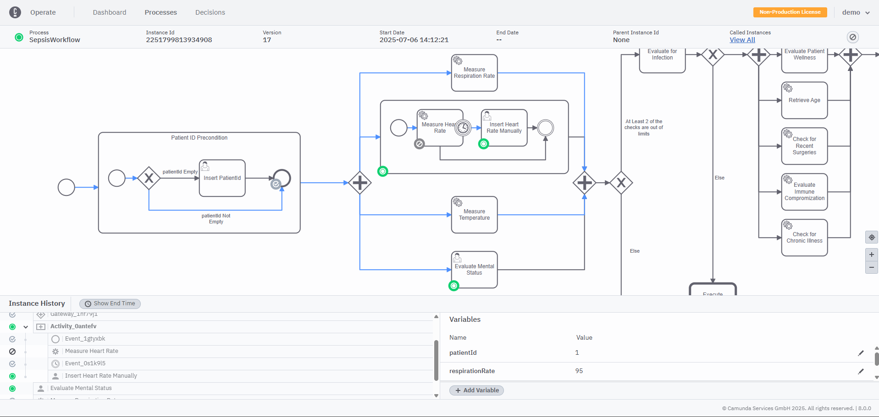
Proof of Concept - Resilience
Notes:
Here day, what happened when a PMm gos down for example? In this case compensation can be offered by the workflow modeling

Slide 25
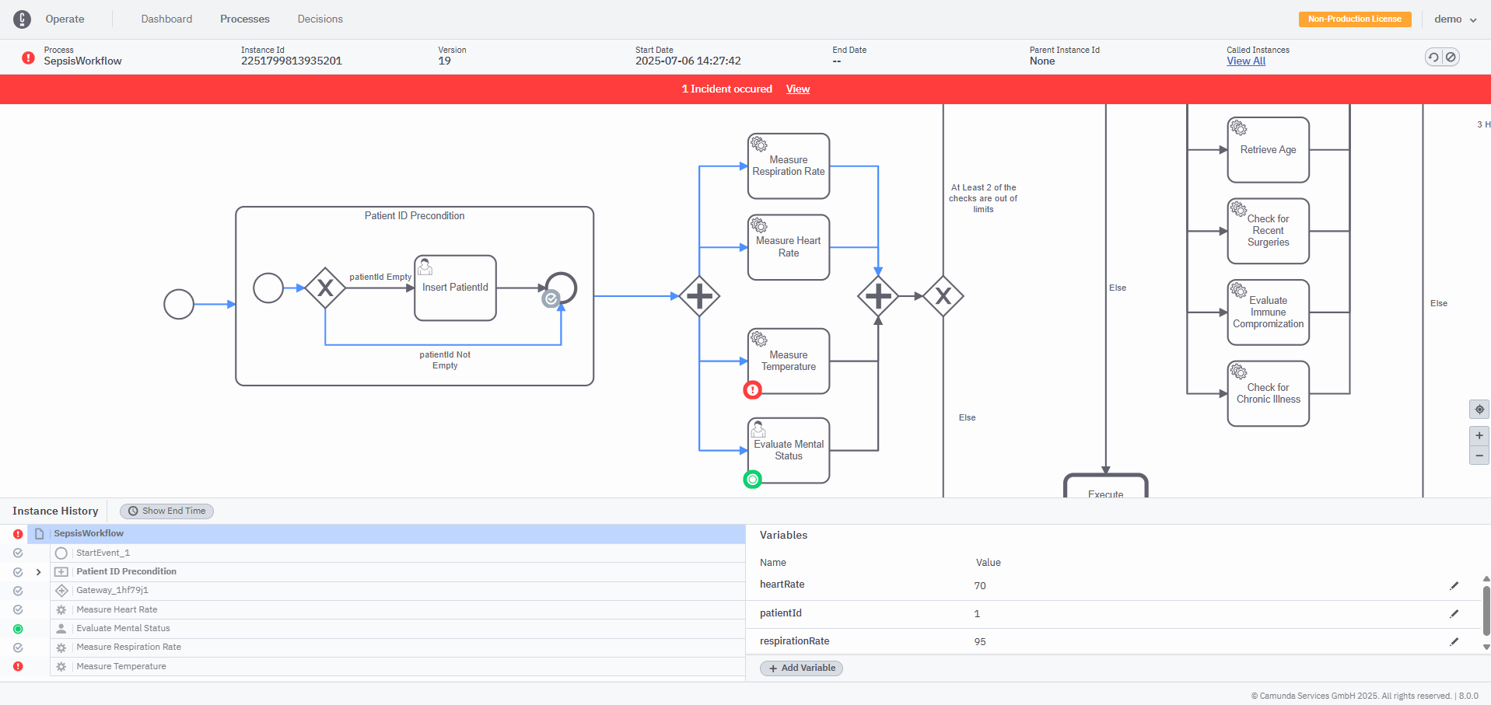
Proof of Concept - Resilience

Slide 26
Evaluation & Results
Goal: Evaluate whether the system meets the 3 core requirements
Method: Apply realistic change scenarios that:
Reconfigure workflows without code changes
Adapt to different external systems
Deploy in flexible ways (centralized/per-patient)
Criteria:
Code-free scenario execution
Fulfillment of system qualities based on their definitions
Maintenance of architecture integrity
Evaluation Results per requirement
Requirement | How It Was Validated
Workflow Configurability | All workflow edits (tasks, actors, transitions, etc.) executed via BPMN
System Adaptability & Integrability | Adaptors enabled/disabled at runtime without code change
Deployment Flexibility | All components deployed in Docker; supports concurrent execution

Slide 27
Results per Quality
Quality | Change Scenarios | Problem Addressed | Captured By | Level of Success
Workflow Configurability | All workflow reconfiguration scenarios (task changes, conditions, transitions, role assignments, etc.) | Enable variation in clinical workflow logic across hospitals without code-level changes | BPMN-based workflow reconfiguration using Camunda Modeler and Zeebe engine | All scenarios successfully demonstrated
Adaptability & Flexibility | External system variability, integrating new systems, multiple responses, deployment alternatives | Accommodate IT heterogeneity and hospital-specific workflows/deployment needs | Modular adaptor system, message broker decoupling, enable/disable adaptors without code-level changes | All scenarios succeeded except mixed deployment (needs practical implementation)
Integrability | Plug-in adaptors for protocol-specific communication, switching between system types | Isolate external protocol logic and enable plug-and-play integration | Adaptors using message broker abstraction and standard message contracts | All scenarios successfully demonstrated
Resilience & Robustness | External system variability, failures/timeouts, retry/fallback actions | Ensure continued operation and graceful degradation under failure | BPMN fallback flows, timer events, post-conditions, persisted workflow state | All scenarios successfully demonstrated
Scalability | Increase in number of patients or concurrently running workflows | Future-proof system for large-scale deployment needs | Modular components, Kubernetes-ready deployment, container-based architecture | Not practically tested but theoretically supported
Extensibility | Adding new UFs or system adaptors | Extend functionality for evolving clinical or IT requirements | Modular architecture, message-based interface contracts | All theoretical scenarios demonstrated successfully
Maintainability & Upgradability | Component-level changes, bug fixes, protocol updates, UF/adaptor upgrades | Safe, localized upgrades and long-term maintainability | Clear separation of concerns, modular independent components | All theoretical scenarios demonstrated successfully
Modularity | Isolated component evolution (e.g., UFs, adaptors, engine) | Allow independent development and replacement of components | Containerized components with publish/subscribe decoupling | Satisfied
Architectural Integrity: Change scenarios does not require architectural changes to be satisfied!

Slide 28
Boundaries & Future Extensions
Rank | Boundary | Impact | Source | Mitigation Effort | Notes
1 | No global transactional consistency | Medium | Design | Medium | Affects workflow correctness when involving multiple UFs or external systems. It requires compensating logic in workflows.
2 | No distributed tracing support | Medium | Implementation | Medium | Affects observability and debugging in workflow execution. This can be addressed using OpenTelemetry and Grafana Tempo.
3 | Single point of failure: message broker | Medium | Implementation | Low | Causes disruption if the broker fails, however can be resolved with high-availability setup in Kubernetes.
4 | No hard real-time guarantees | Low–Medium | Implementation | Medium | Relevant only if strict timing constraints are introduced. Bounded behavior can be achieved with rate limiting and resource management.
5 | Assumption of prebuilt adaptors/UFs | Low | Design | Low | Common in integration-heavy systems. New adaptors are added as needed per external system type without affecting any other system component.
6 | Per-hospital vs. shared deployment | Low | Implementation | Low | Architecture supports both. Shared deployments require standard tenant isolation mechanisms for data protection.

Slide 29
Research Questions Answers (1)
RQ1: What are the key characteristics and evolving requirements of clinical workflows & CWS that should be supported by the proposed system design?
Identified three core system requirements:
Workflow Configurability
System Adaptability, Flexibility & Integrability
Deployment Flexibility & Adaptability
Grounded in literature, expert input, and PESTEL analysis
Linked to 11 system qualities guiding architecture, for each one a contextualized definition for CWS has given
Key driver qualities: Configurability, Adaptability, Flexibility and Integrability.

Slide 30
Research Questions Answers (2)
RQ2: How can the CWS architecture be designed to support workflow configurability and system adaptability without requiring code-level modification and satisfy the identified current and future system requirements?
Architecture main components includes Workflow Editor & Engine, UFs, Adaptors, Message Broker
Main Concepts:
Workflow definition expressed in configuration file
Workflow control logic separated from functional logic (UFs)
Adaptors for enabling system environmental adaptability, flexibility
UFs- Adaptors decoupling via Publish/Subscribe communication style
Modular architecture with clear separation of concerns for preserving architectural integrity
Trade-offs acknowledged:
Centralized orchestration vs. single point of failure
High Modularity vs. higher initial design and implementation & deployment overhead - Multi-layer tracing/debugging complexity
Patient to system mapping in adaptors/ Clear separation of concerns vs. Increased message filtering load in adaptors

Slide 31
Research Questions Answers
RQ3: What are appropriate criteria/metrics/questions for assessing evolvability of CWS?
Three evaluation criteria:
Generated change scenarios require no code-level changes
Qualities are realized and observable in architecture
Architectural integrity is preserved
Method:
Applied change scenarios to evaluate system ability to support requirements
Mapped each quality to the problem addressed, the architectural concept used, the evaluation outcome
Identified system boundaries & limitations: no blocking limitations originate in the design

Slide 32
Main Contributions
A generalizable system architecture for evolvable CWS (The architecture is generalizable beyond clinical settings)
Comparison with existing work reveals two key innovations
Clear separation of workflow logic from functional logic through UFs – not addressed in earlier systems. Improves workflow maintainability and reconfiguration efficiency as reduces testing and complexity.
Explicit support for external system heterogeneity through adaptors – overcoming the assumption of standardized environments common in prior studies.
Single CWS release, customization through configuration (workflow, active adaptors, deployment)
Demonstrated capability to evolve without code-level changes/practical implementation and validation via change scenarios
Methodology on how design an evolvable CWS
Adding semantic validation of workflows.
Further analysis of mixed deployments and multi-CWS collaboration.
Future Work
Notes:
While existing approaches address individual aspects of these stages (e.g., BPMN for workflow structuring), the proposed solution offers a more integrated
and generalizable design, explicitly tailored for clinical workflow variability and evolution

Slide 33
Thank you for your attention ☺

Slide 34
Backup Slides - Discussion
Core Supported Data Types in the CWS:
Workflow Definition Data : e.g., YAML/JSON files
Patient-Specific Data: Patient ID & contextual input like age, heart rate, chronic illness, surgery history.
Workflow Instance Data: Runtime metadata such as process IDs, job IDs, timestamps, execution state
Requests between UFs and adaptors are captured in the topics of the messages.
Architectural concepts used:
Workflow Configurability: Configuration files + Execution Engine
Control–Functional Logic Decoupling for increased maintainability less testing: Unit Functions (UFs) encapsulate functionality separately from workflow logic
Decoupling from External Systems Adaptors handle external system variability: Message Broker enables loose coupling and asynchronous communication
Modular Architecture: Independently deployable components (UFs, Adaptors, Engine)
Configuration over Code: Evolution and customization achieved via config changes, not code changes
What still needs code level changes?
Maintenance/upgrade of independent component- still optimized because of modularity
When a new UFs or Adaptors need to be added into the system

Slide 35
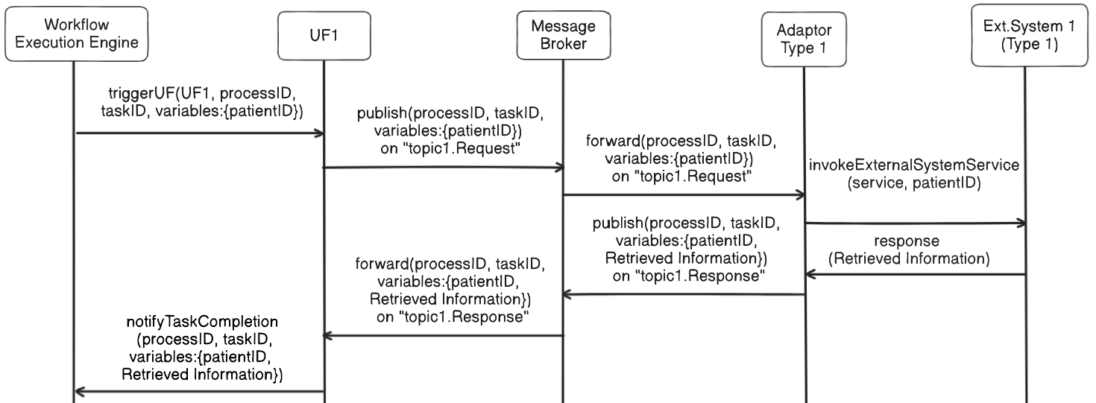
Backup Slides – Automated task execution
Figure2: Automated Task Execution

Slide 36
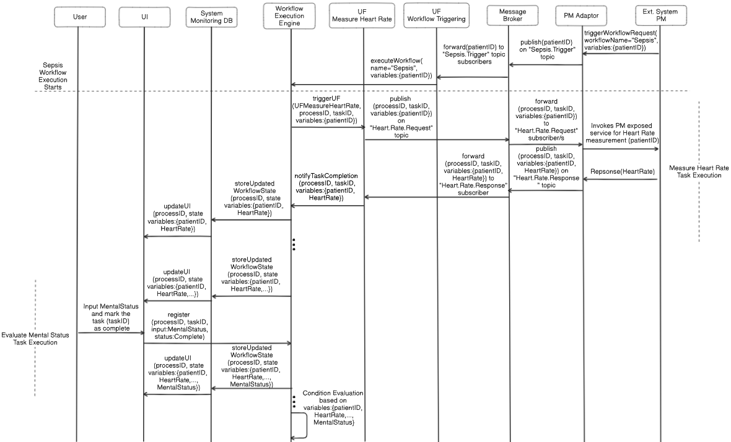
Backup Slides - System Behavior – Full Example
Figure2: Automated Task Execution

Slide 37
Backup Slides - Design Alternatives
Data-Oriented (Dataflow) Design - Execution driven by data availability - Lacks control flow & decision logic → not suitable for clinical workflows
Decentralized Orchistration (No Central Engine) - Each UF interprets workflow & updates state - Increases complexity, harder to trace & debug
Multi-Protocol Handling Without Adaptors
- Integration of translation into all components or Ufs to handle all integration protocols - Leads to rigidity, poor evolvability

Slide 38
Backup Slides - Self Adaptive Adaptor – High level Idea
Self adaptive adaptor could look like this:
One adaptor in general instead of one per type
Implements the translation between the external system and CWS
Different interoperability protocols expressed in configuration files
The adaptor identifies external request “language” and load the correct configuration file to make the translation to CWS language

Slide 39
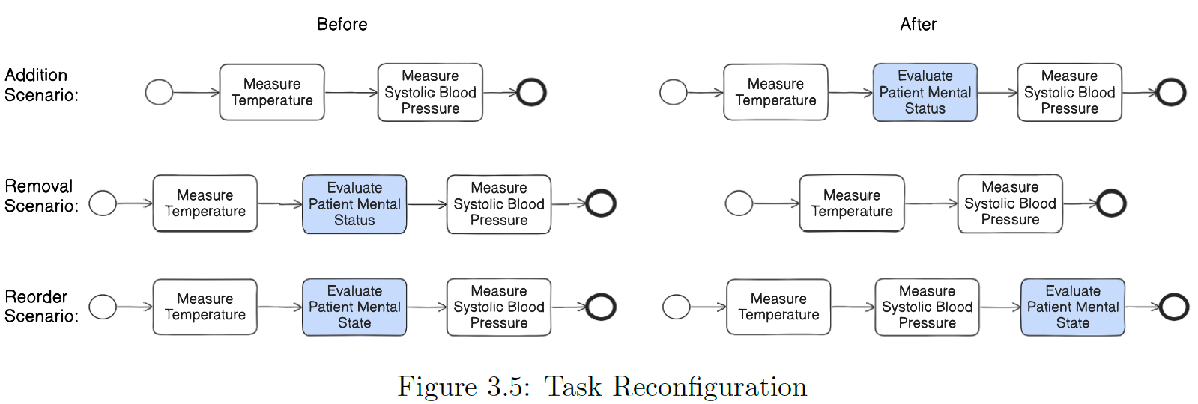
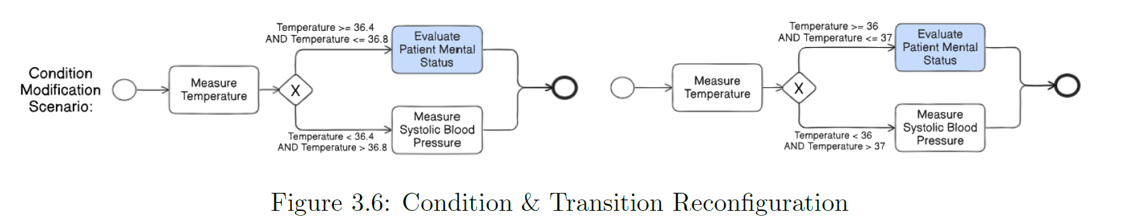
Change Scenarios Examples

Slide 40
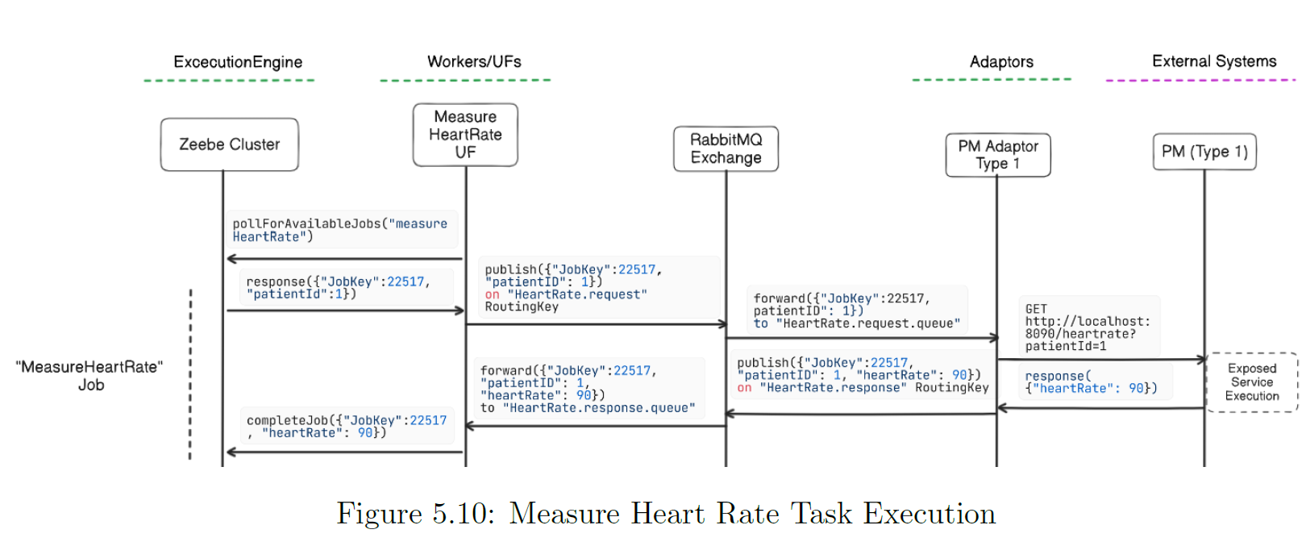
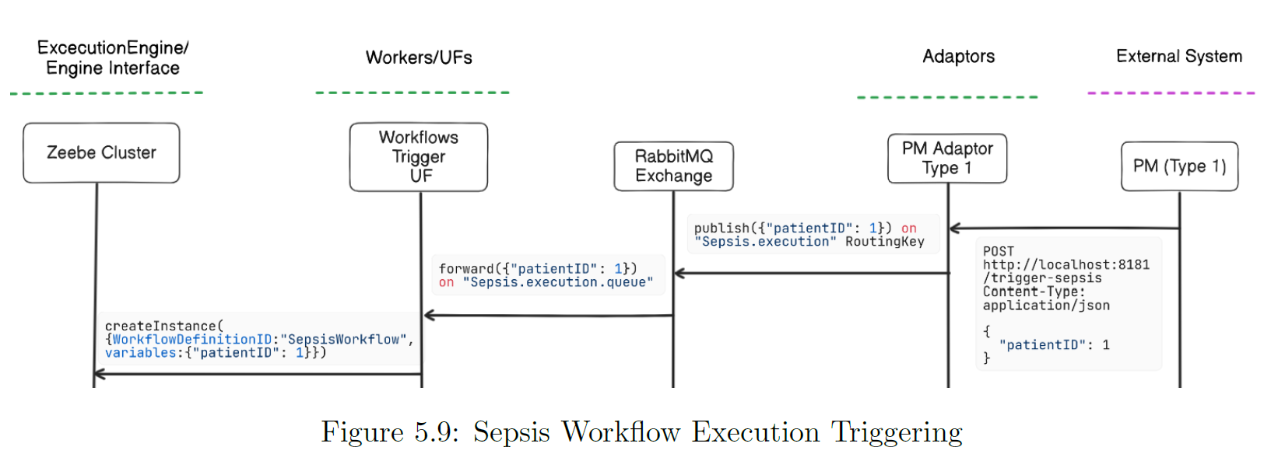
Backup Slides - Proof of concept

Slide 41
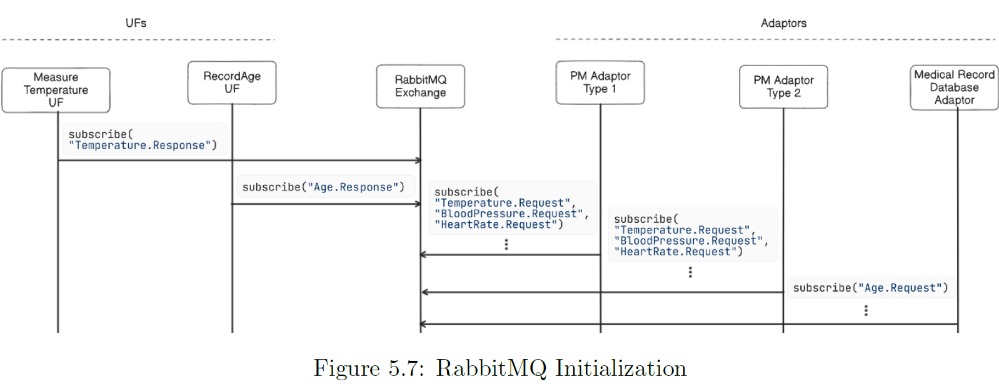
Backup Slides - Proof of concept

Slide 42
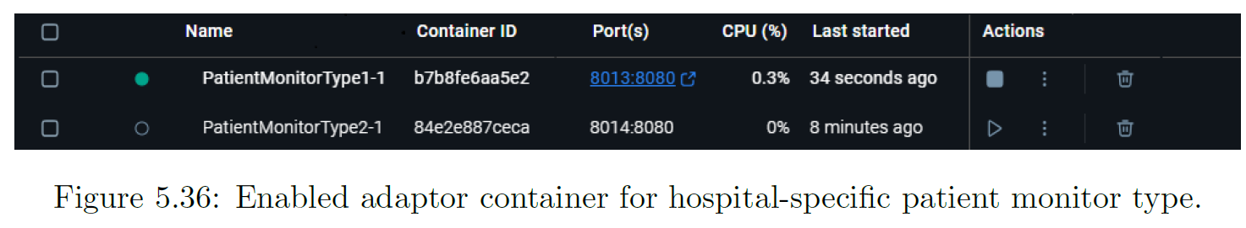
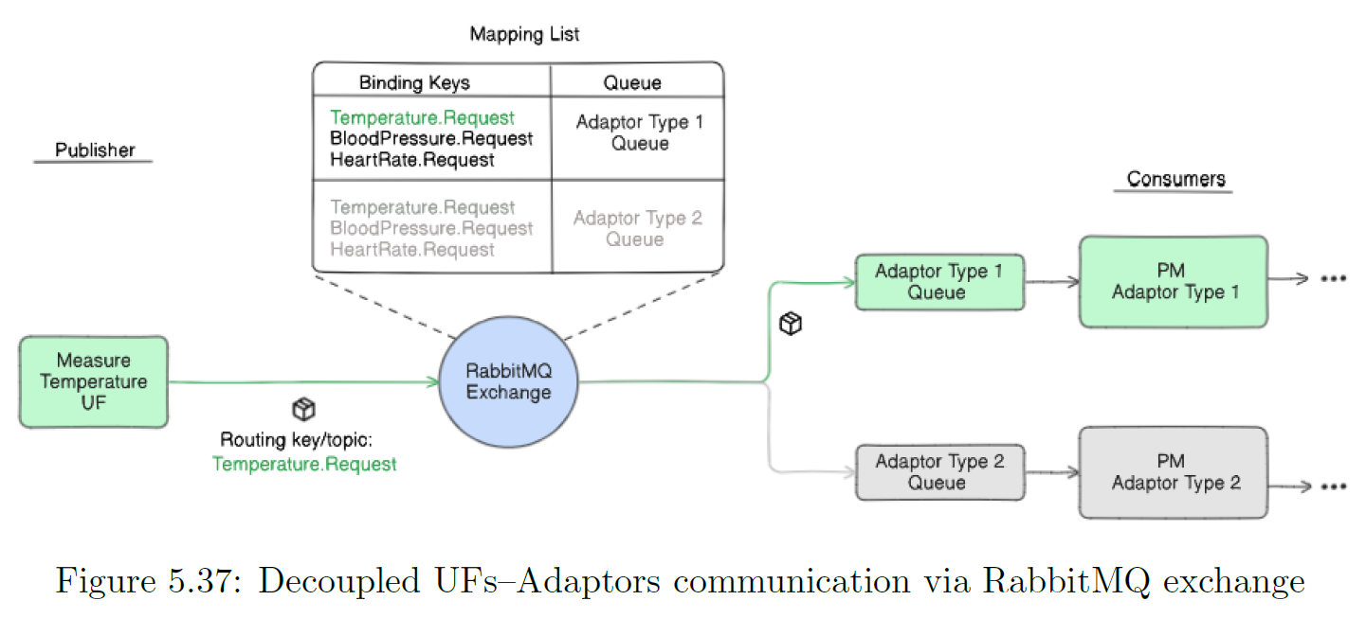
Backup Slides - Change Scenarios Examples Proof of concept

Slide 43
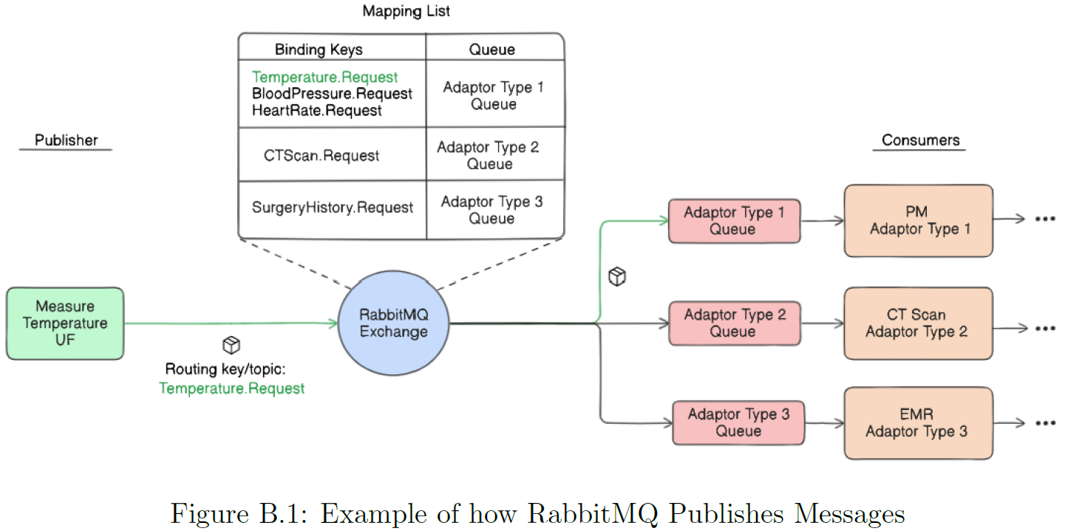
Backup Slides - Change Scenarios Examples Proof of concept

Slide 44
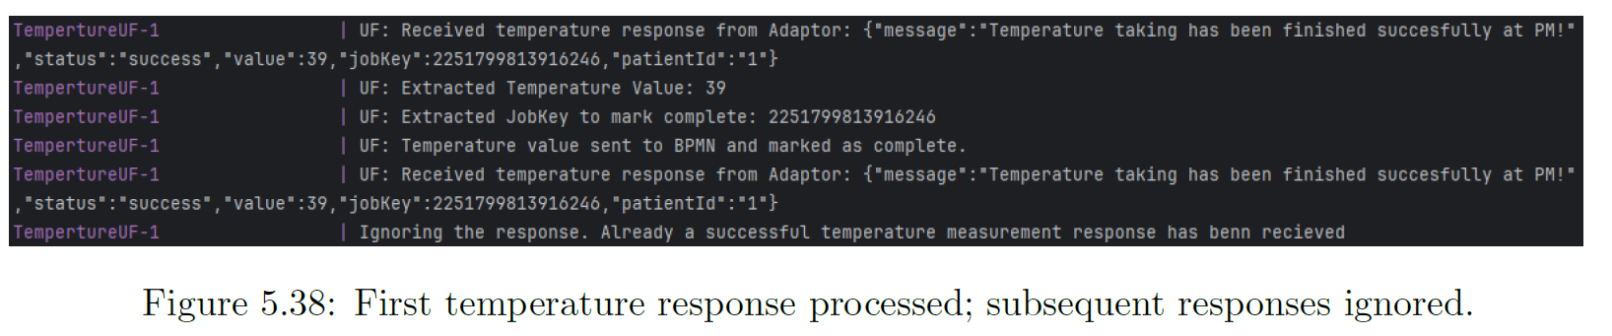
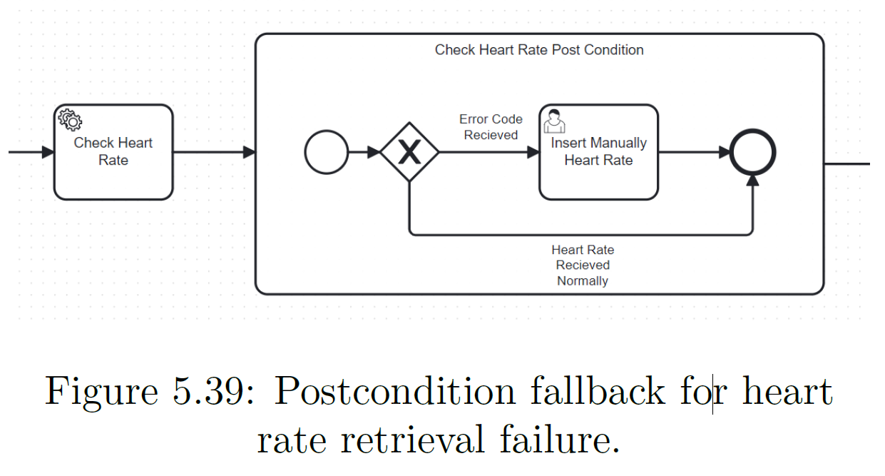
Backup Slides - Change Scenarios Examples Proof of concept

Slide 45
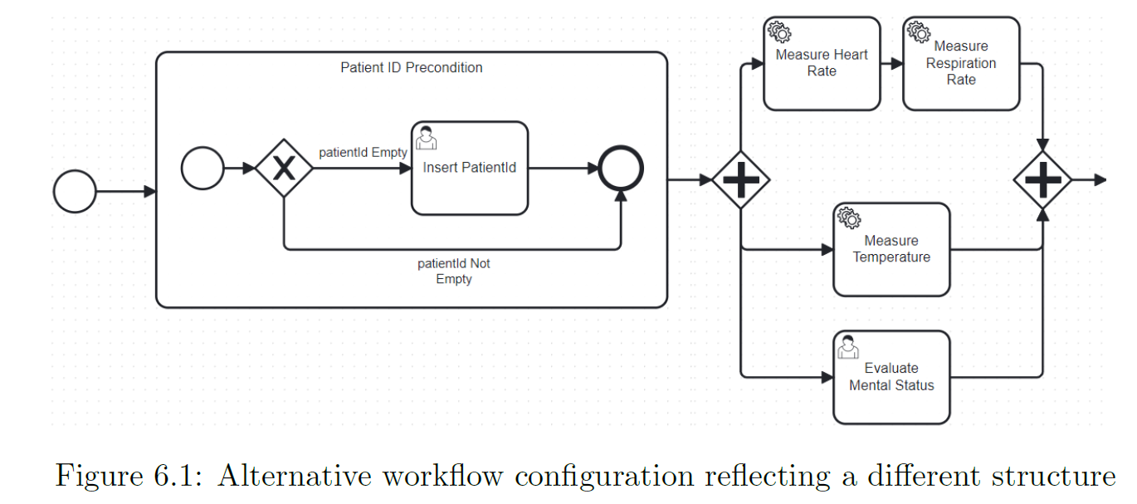
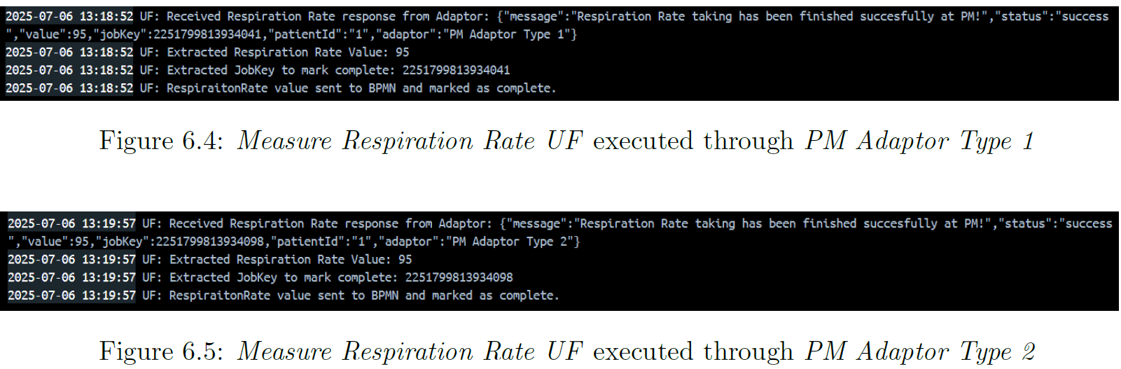
Backup Slides - Change Scenarios Examples Proof of concept

Slide 46
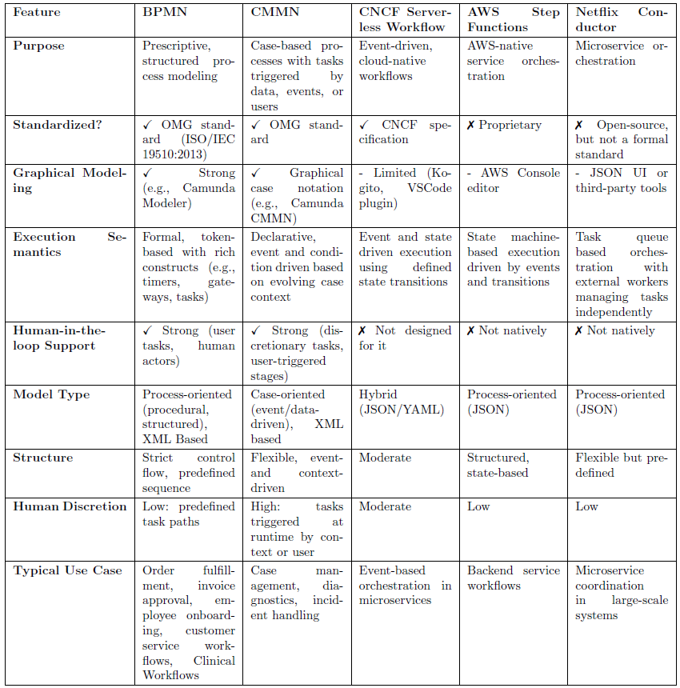
Backup Slides - BPMN CMMN and other alternatives

